Slide 1
Strengthening innovative cooperation among BRICS countries to achieve stable economic growth
Anna Nesterova
Chairperson of the Board of Directors Global Rus Trade
Head of Russian Working Group on Digital Economy of BRICS Business Council

Slide 2
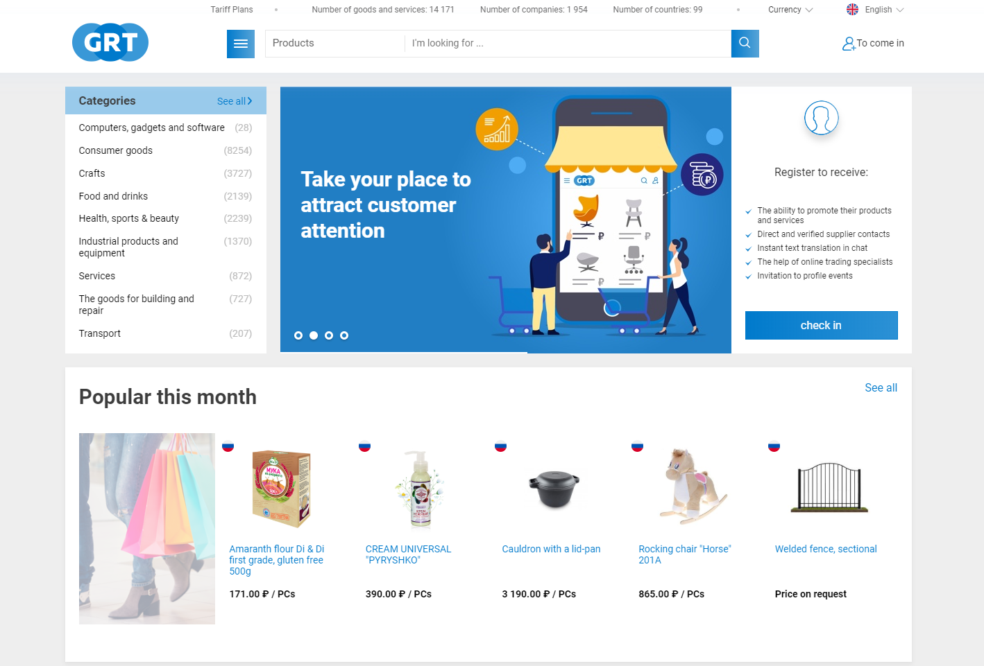
GlobalRusTrade.com
The first Russian platform for cross-border B2В e-commerce
GRT is a user-friendly service to sell, buy and promote goods and services in Russia and worldwide
Founded in 2015

Slide 3
GlobalRusTrade.com
4 years
in the e-commerce market
> 3000
registered enterprises
101
countries of presence

Slide 4
The most popular categories
Consumer goods
Handicrafts
Health, sport and beauty
Food and drinks
Industrial goods and equipment

Slide 5
GlobalRusTrade.com – Advantages
Translation of content and messages into 11 languages
Languages spoken by 80% of the total world population
Check of all companies at the platform
It has become easier now to assess partners’ integrity

Slide 6
Potential of e-commerce market in BRICS and Russia
By 2022 global cross-border online retail among BRICS countries will reach 554 billion dollars and online retail sales of BRICS will rise to 3 trillion dollars
Russian e-commerce market will almost triple by 2024 and amount to 60 billion dollars

Slide 7
E-commerce development in Russia
Russia benefits from high Internet (almost 80%) and smartphones (66%) penetration
Investments in the Russian e-commerce market may reach 1 billion dollars in the following years
By 2025 the share of e-commerce market should grow to 20% from the present 3-4%. It is assumed that Russia's share in the global e-commerce market will be 10%

Slide 8
BRICS Business Council
Global Rus Trade heads the Russian BRICS Business Council Digital Economy Working Group
Main focus areas:
Connectivity and Inclusion Goals
Narrowing Digital Divide
Market Access and SME Business Innovation Drive
Development of Digital Technologies and Platforms

Slide 9
BRICS Digital Literacy School
A platform which combines best educational practices and unites people of different professions and generations of all five BRICS countries
Define digital literacy level
Define best practices of online and offline education in BRICS countries
Develop recommendations on increasing digital literacy among BRICS countries
Create digital literacy courses depending on the main necessities of each country's population

Slide 10
BRICS E-Commerce Platforms Network
Exchange of experience and information in the field of e-commerce
Exchange of RFQs (Request for quotation)
Developing a standardized form of RFQ
Placement of cross-references to partner`s websites
Organization of meetings, conferences, seminars
Placement of brief information about the platform in educational materials

Slide 11
Thank you for your attention!
Anna Nesterova
Chairperson of the Board of Directors Global Rus Trade
Head of Russian Working Group on Digital Economy of BRICS Business Council
info@globalrustrade.com
+7 (495) 646 56 01
Global RUS Trade
GlobalRusTrade

