Slide 1
The Development of E-Commerce in China

Slide 2
In 2018, global retail transaction volume amounted to approximately US$23.946 trillion, an increase of 5.8% year⁃on⁃year; in 2018, global online retail transaction volume
amounted to US$2. 842 trillion, with a year⁃on⁃ year growth of 23.3%, 17.5 percentage points higher than the growth rate of global retail transactions.

Slide 3
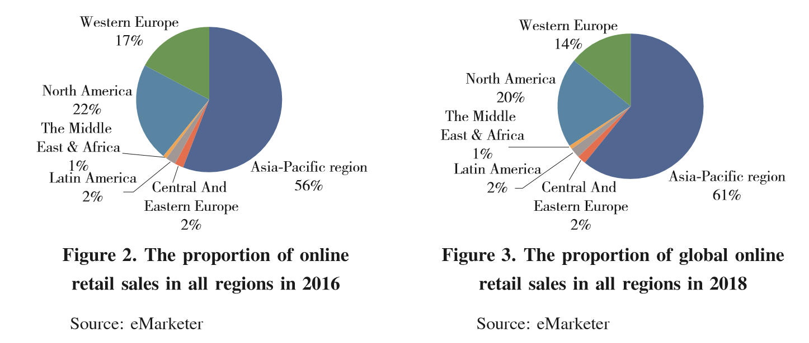

Slide 4
in 2018, the volume of e⁃ commerce transactions in China reached 31.63 trillion yuan, an increase of 8.5% year on year. The online retail sales exceeded 9 trillion yuan, a year⁃on⁃year increase of 23.9%.
The online retail sales of physical goods exceeded 7 trillion yuan, accounting for 18.4% of the total retail sales of consumer goods.

Slide 5
The total amount of imports and exports through the customs system in 2018 was
134. 7 billion yuan, an increase of 50% year on year.
The total exports were 56.12 billion yuan, an increase of 67%; the total imports were 78.58 billion yuan, an increase of 39.8%.
Compared with 2017, the export growth rate increased by 25.7 percentage points; imports still accounted for more than 55% of the total, but the growth rate has slowed down.
According to the business big data monitoring, the top three imports in 2018 were “cosmetics”, “grain/oil/food”, “clothing/ shoes/hats”, accounting for 35. 9%, 24.2% and 13. 3%, respectively.

Slide 6
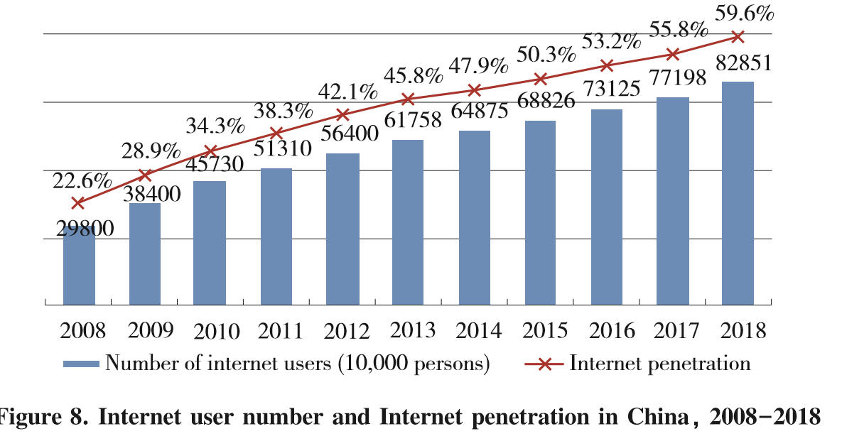
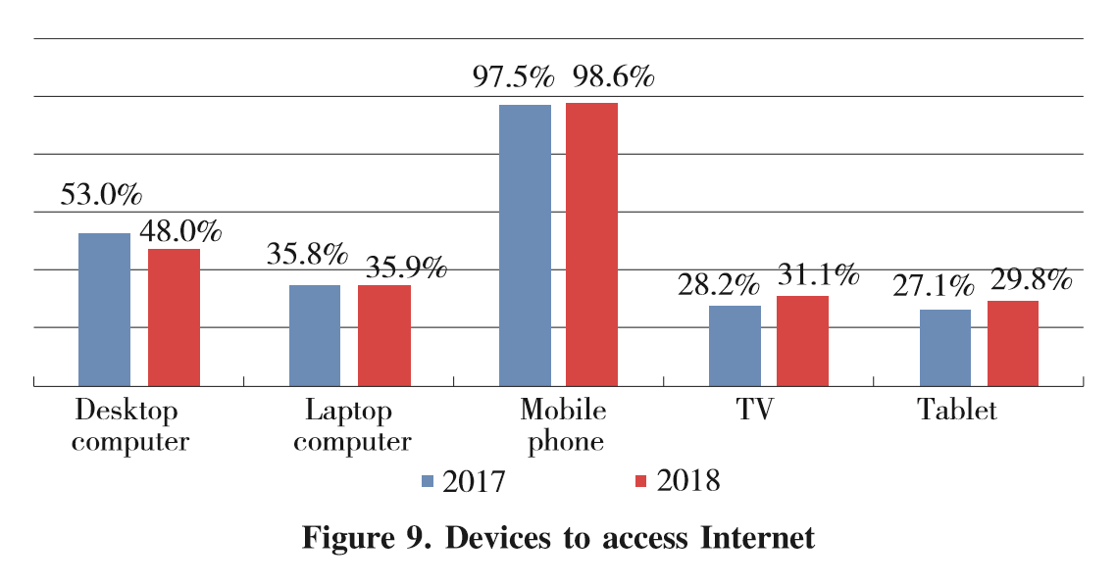
The number of Internet users continues to increase, and the mobile terminal has become an important entrance.

Slide 7
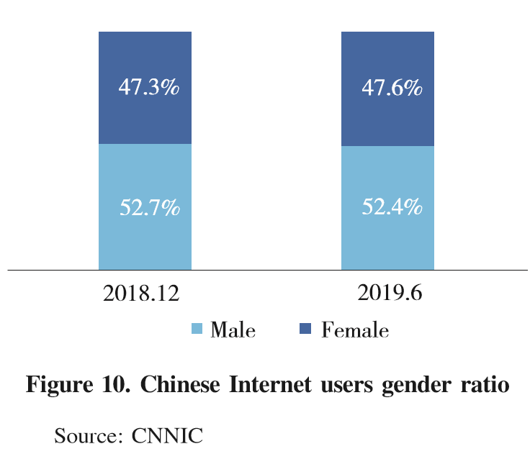
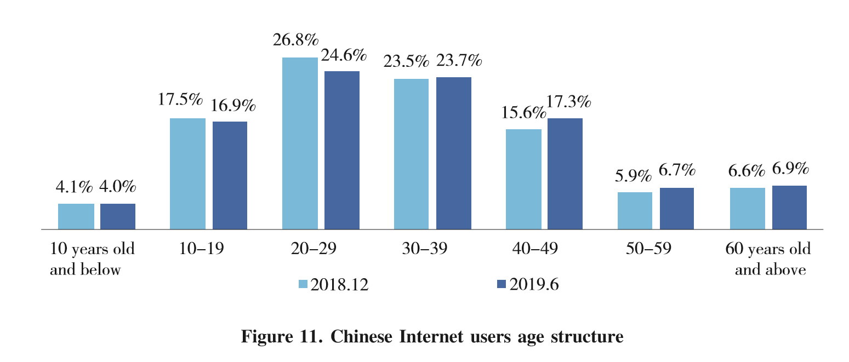
Daily necessities are the main category of e⁃commerce consumption, and the growth rate of consumption of Smart products is accelerating􀆰
The gender difference of online shopping is not big, and the age gradually penetrates into the middle⁃aged and old people.

Slide 8
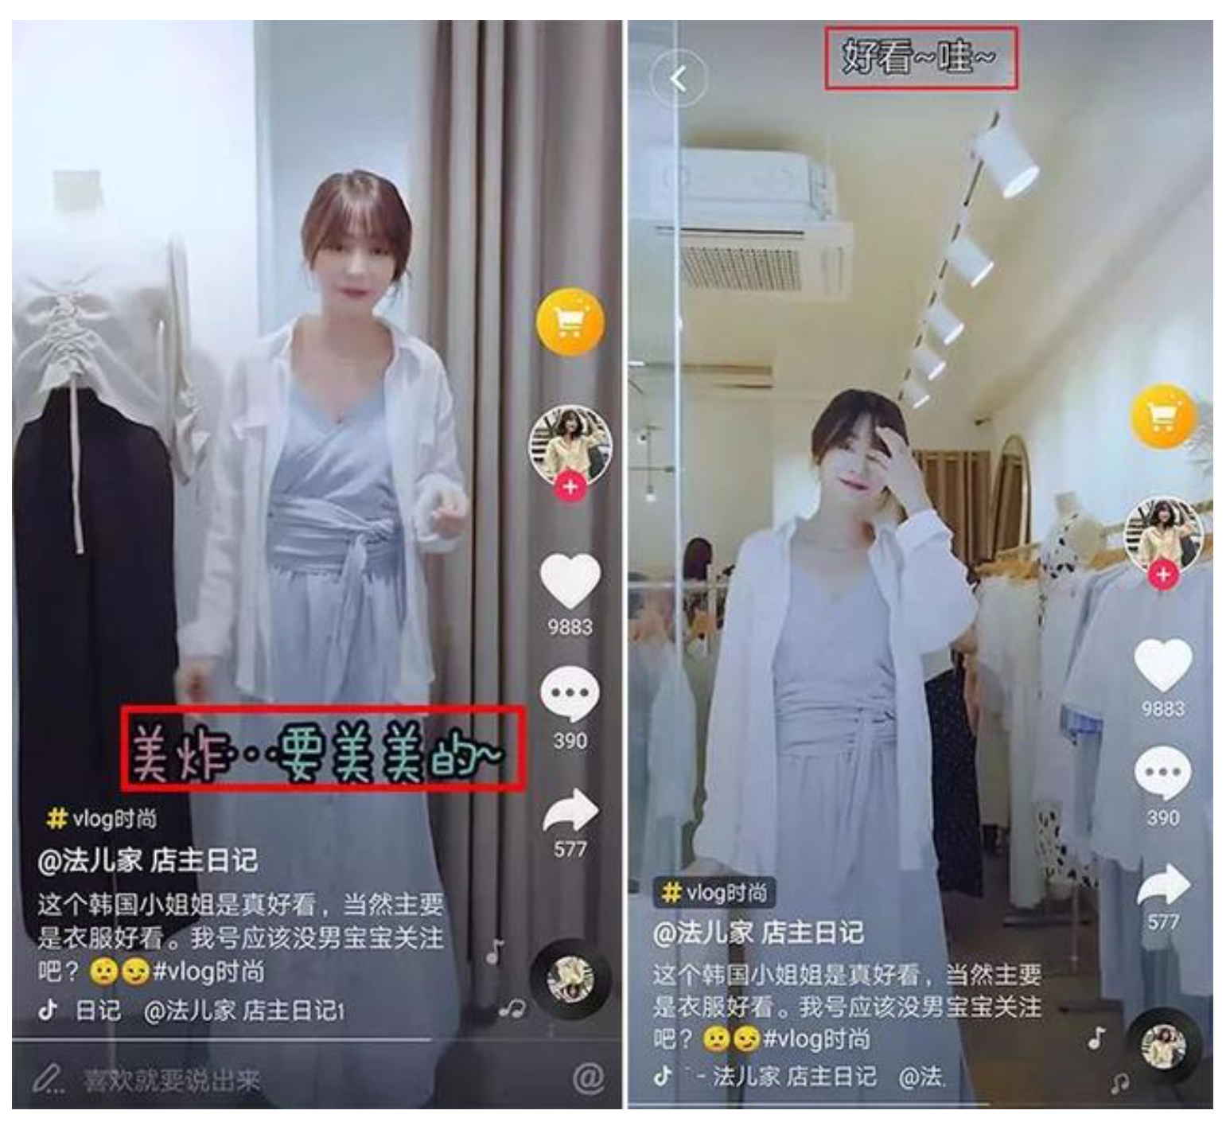
The social innovation mode activates the consumption potential of online shopping.

Slide 9
Firstly, on August 31, 2018, the Electronic Commerce Law of the People’s Republic of China was released and took effect from January 1, 2019.
Secondly, a number of policies have been introduced to promote cross⁃border e⁃commerce development.
The third is to strengthen the regulation
over the dishonesty behaviors and intellectual property protection in the field of e⁃commerce.
Notes:
Firstly, on August 31, 2018, the Electronic Commerce Law of the People􀆳s Republic of China was released and took effect from January
1, 2019. This law aims to promote, standardize and guarantee the high⁃quality development of e⁃ commerce, and provides a basis for relevant
laws, regulations, policies and the introduction of standards. It is the first comprehensive e⁃ commerce law in the world.
Secondly, a number of policies have been introduced to promote cross⁃border e⁃commerce development. In 2018, China introduced a regulation policy on cross⁃border e⁃commerce retail import, specifying that cross⁃border e⁃ commerce retail imports are regulated according
to personal use of inbound goods. While expanding the list of retail imports, the limiting value has also been increased: the single transaction limit has been raised from 2000 to 5000 yuan, and the annual transaction limit has been raised from 20000 to 26000 yuan. The VAT and consumption tax exemption policies

Slide 10
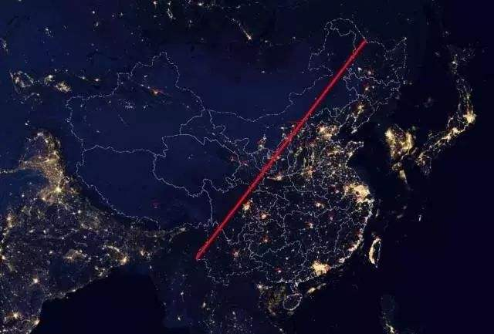
Infrastructure
Policy Supported
Shortage of traditional sale system
Large consumer base

Slide 11
Du Guochen
Researcher and Deputy Director
Institute of E-Commerce Research
Chinese Academy of International Trade and Economic Cooperation (CAITEC)

